Slide 1



Slide 2

A Quick History Lesson

Slide 3
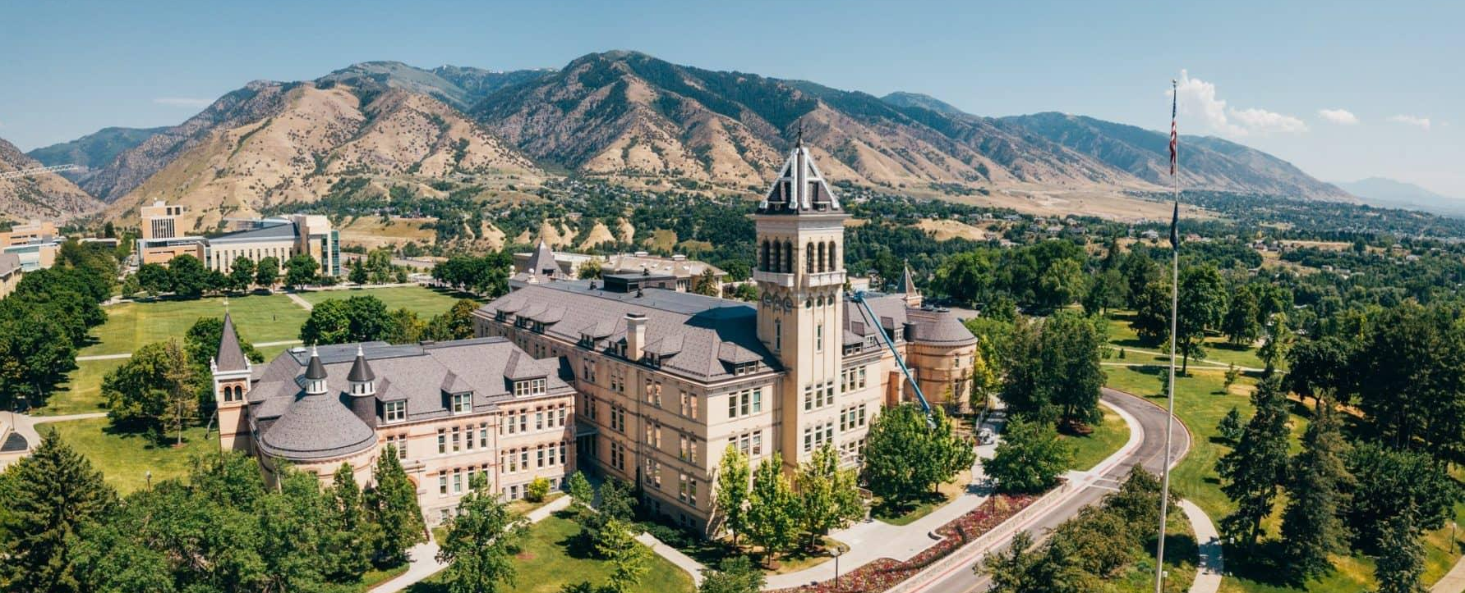
Utah State University
Serving Students since 1888

Slide 4
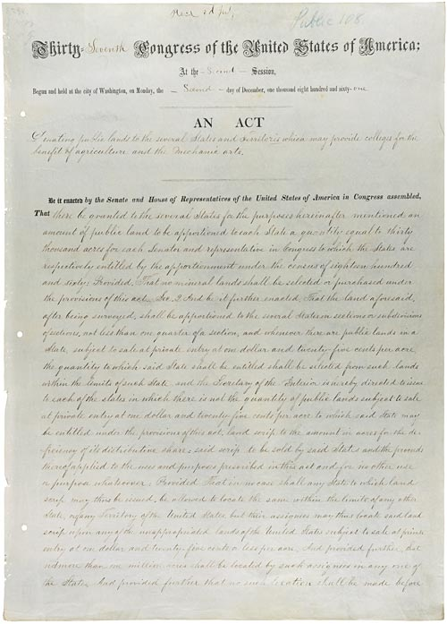
Utah State University
Utah’s Land-grant University
>

Slide 5
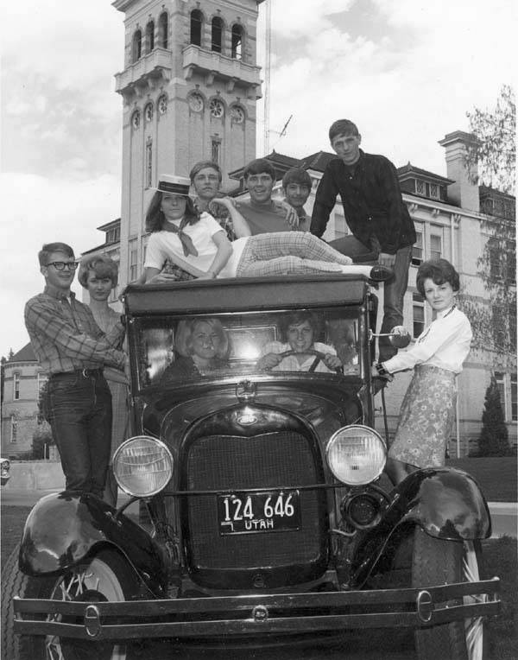
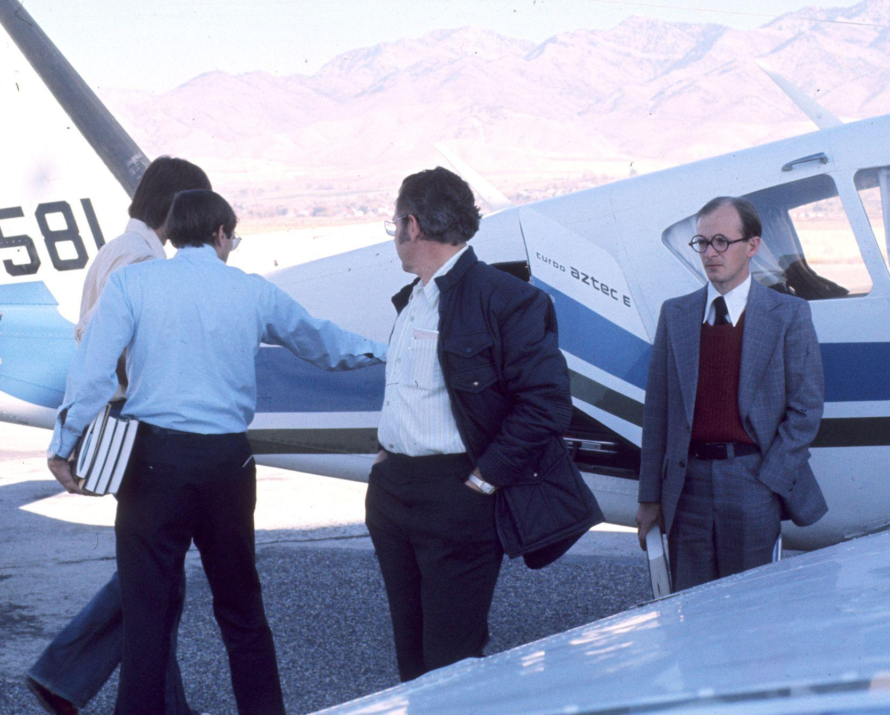
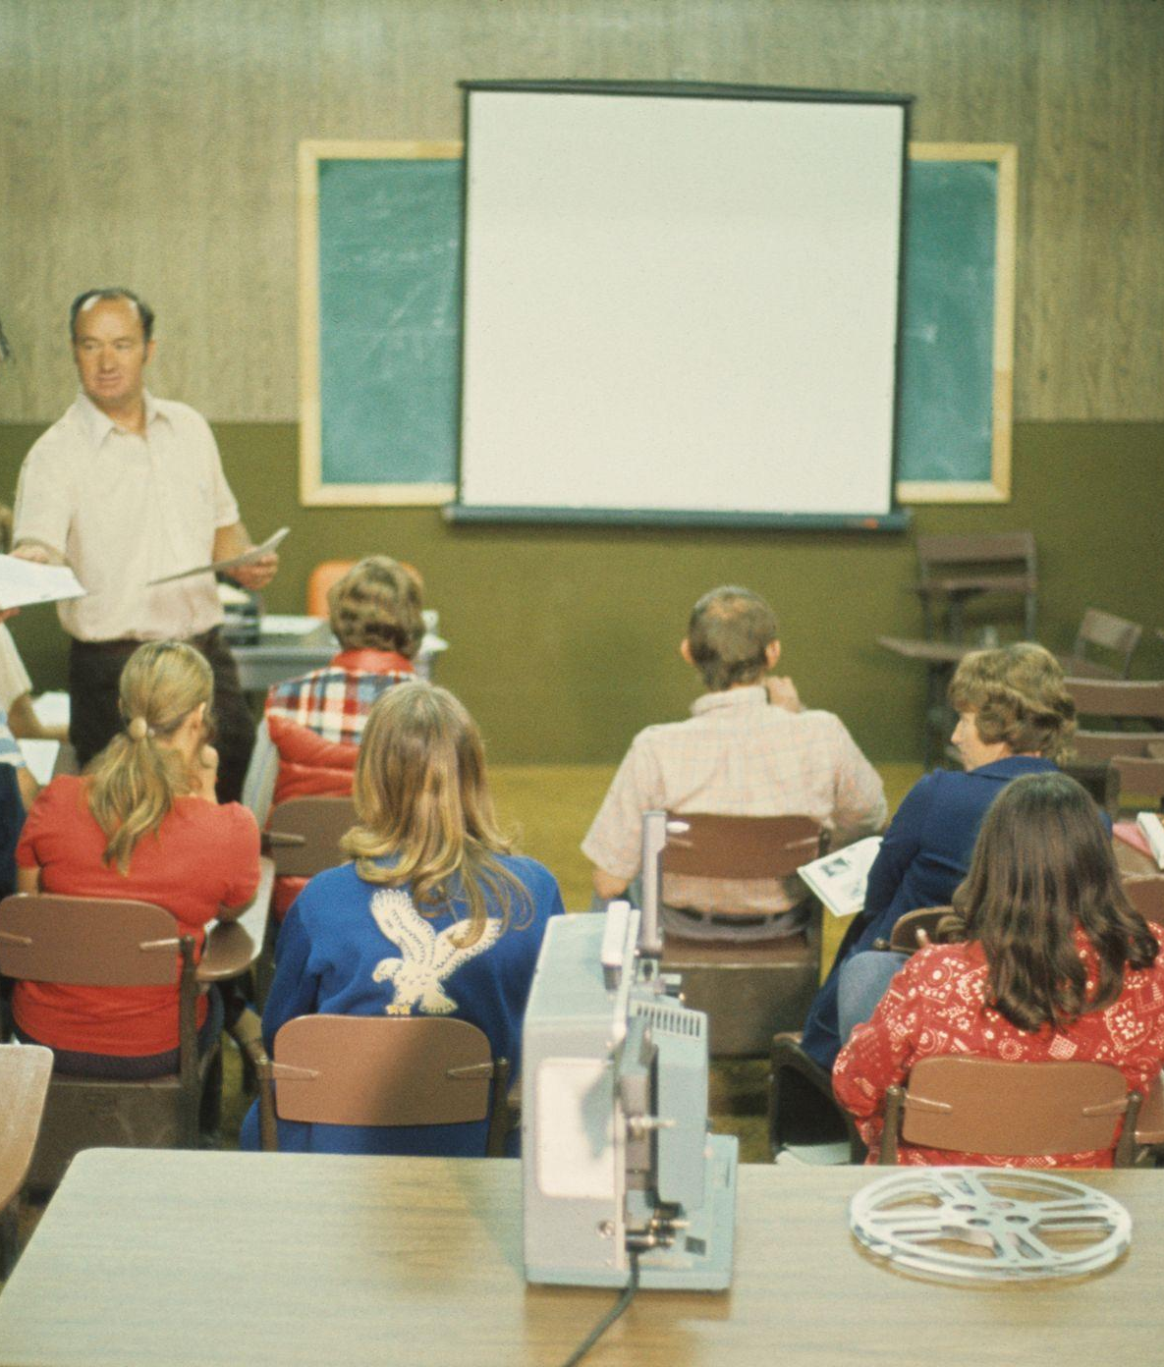

Utah State University
Trains, Planes, and Automobiles

Slide 6
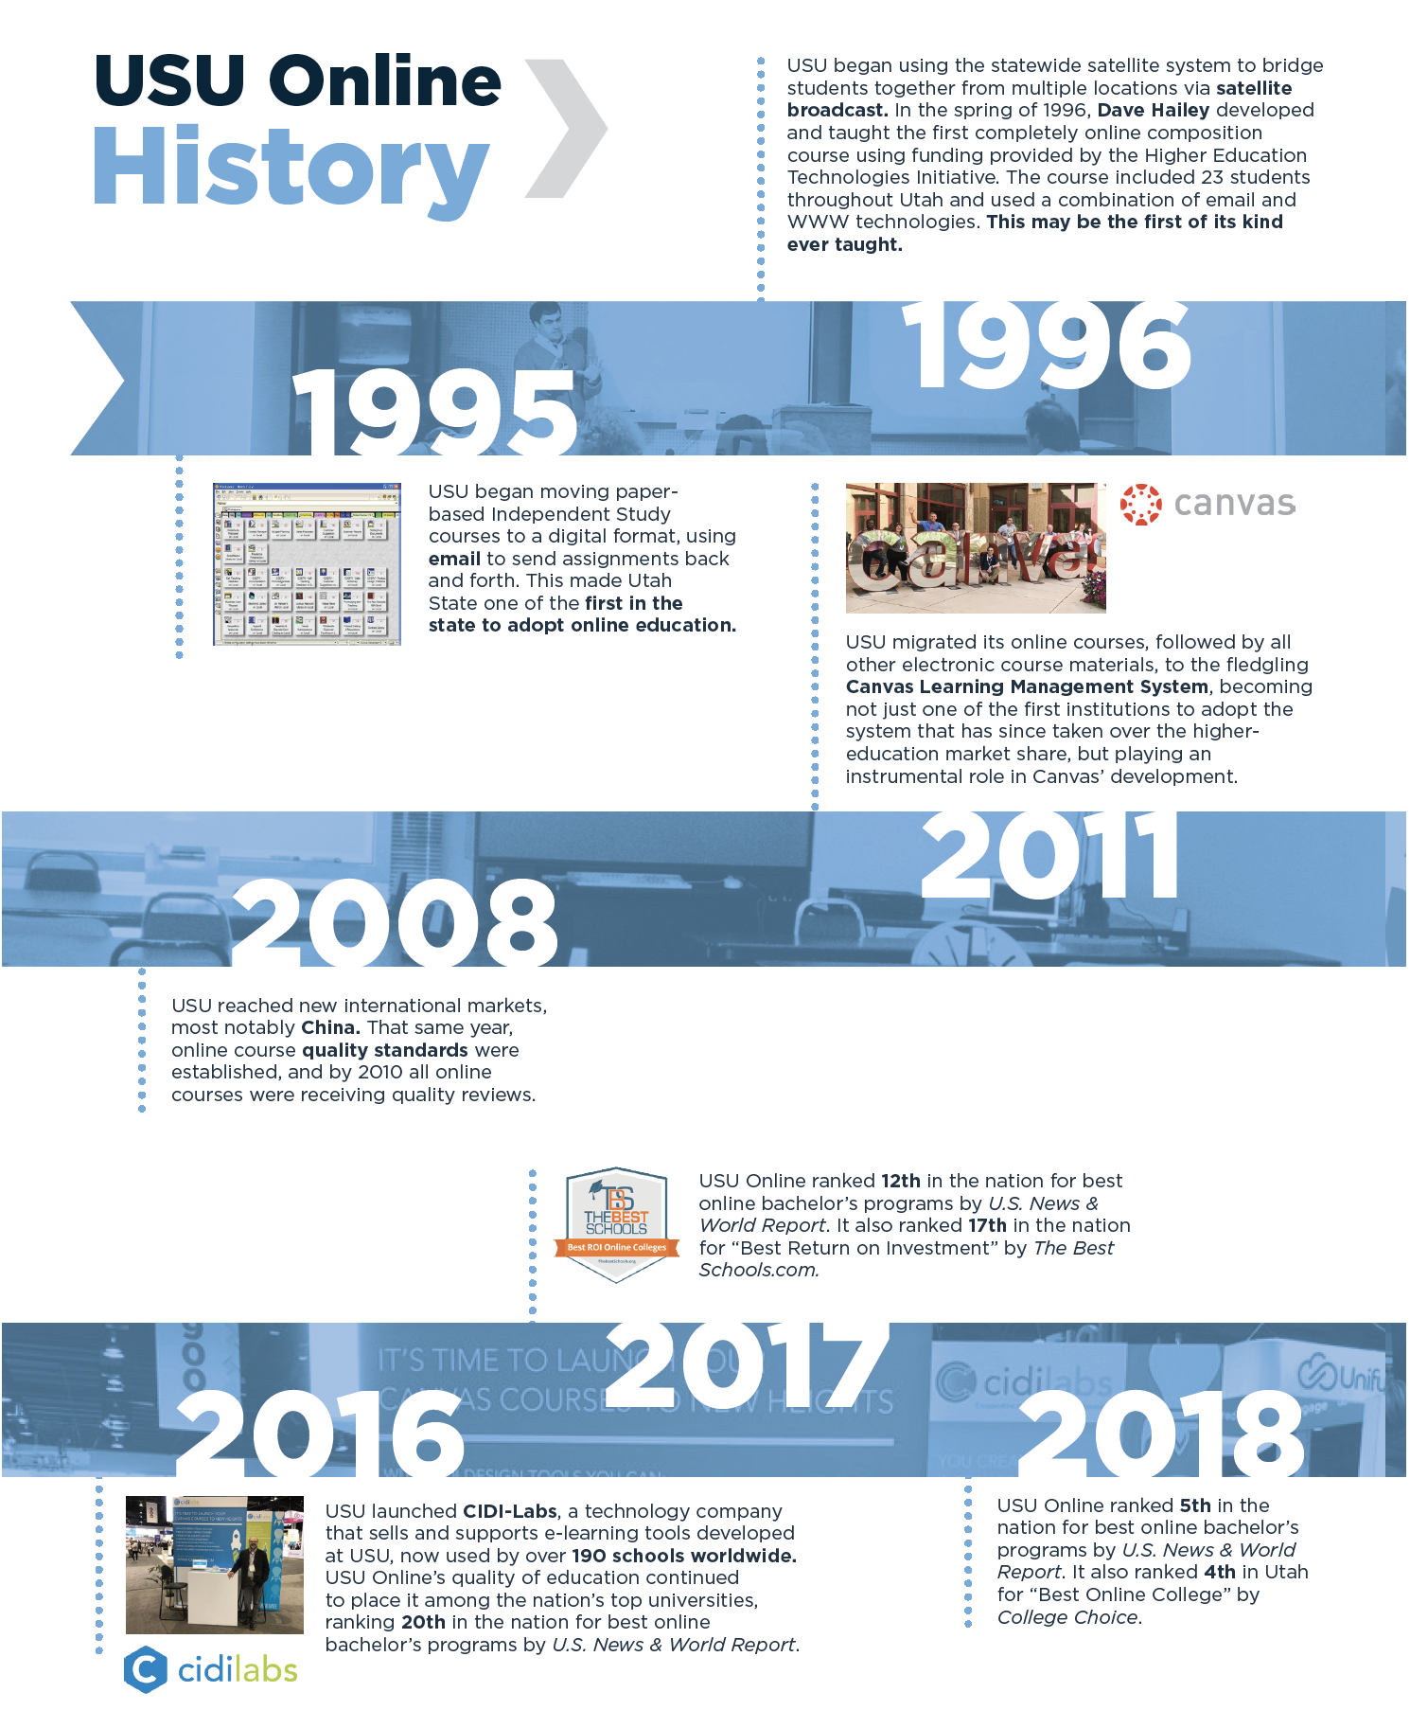
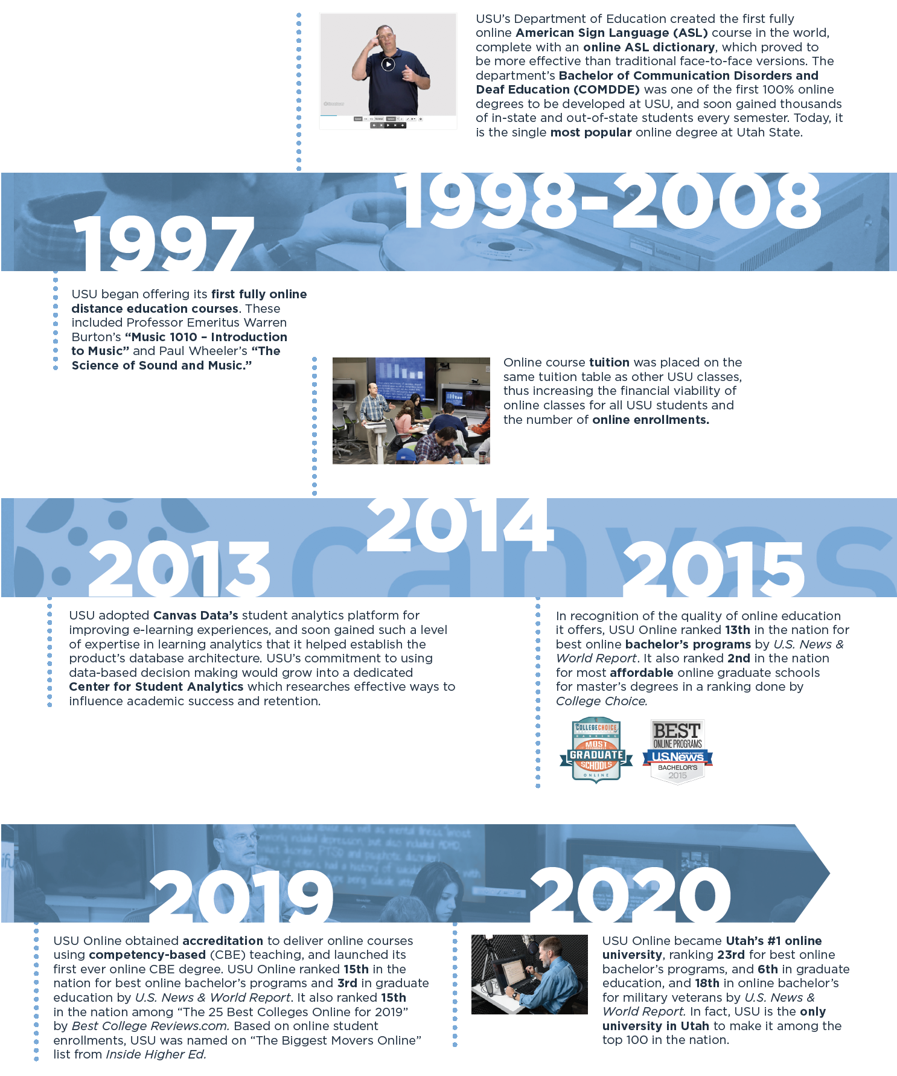

Slide 7


Utah State University
Main Student Populations
25+
Traditional (Residential)
Post-traditional (Non-residential)

Slide 8






Utah State University
Post-traditional Access Challenges
Institutional
Academic
Situational
Attitudinal

Slide 9
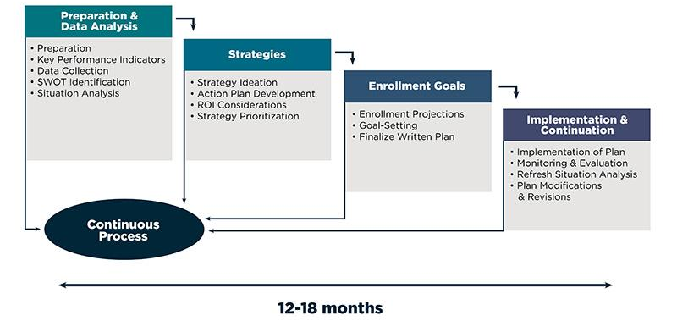
Utah State University
Strategic Enrollment Management Plan

Slide 10

Post-traditional Barriers & Challenges

Slide 11



Utah State University
Post-traditional Student Traits
Enrollment
Patterns
Financial And Family Status
High School Graduation Status
Graduated high school 2+ years prior
Part-time attendance
Has dependent children
Single parent
Employed full-time
GED certificate
Other equivalency diploma for high school

Slide 12

Utah State University
National Post-traditional Stats
74
of undergraduates meet at least one non-traditional student criteria.
47
of people entering college are over 25 year old. 40% are over 35.
44
of the 4.3 million student parents work full time. 55% of mothers are single parents.
30
of all entering freshmen are first generation.

Slide 13




Utah State University
Post-traditional Student Challenges
Time
Cost
Technology
Confidence

Slide 14

Utah State University
Post-traditional Student Challenges

Slide 15

Post-traditional Opportunities & Resources

Slide 16


Accessibility • Quality • Affordability

Slide 17
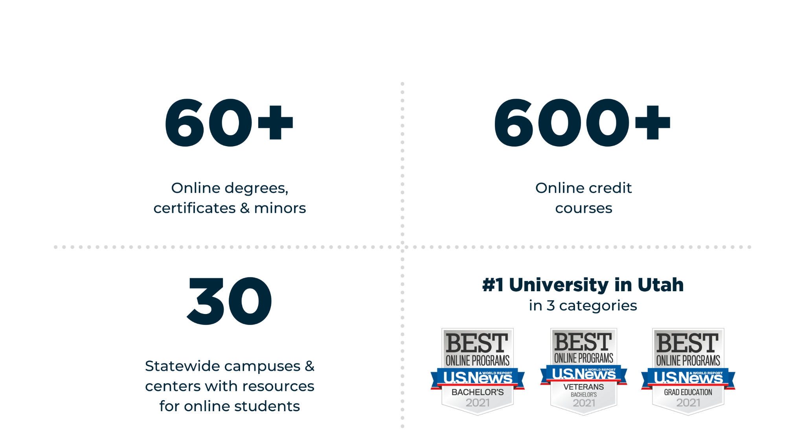
Utah State University
Online Educational Offering

Slide 18



Utah State University
Online Educational Offering
Academic Degrees
Online Academic Offerings
3 Associate Degrees
16 Bachelor Degrees
17 Master Degrees
23 Minors
6 Undergraduate Certificates
4 Graduate Certificates
3 Professional Licensures/Endorsements
Traditional & CBE teaching
Curriculum mapping
Continuing Education
Professional CEUs
Improve know-how & skills
Outreach Courses
Certificates & Badges
Custom content & pathways

Slide 19
NEW USU Program Launches
CERTIFICATES
Computer Science
Inclusive Leadership
COMPLETION PROGRAMS
Integrated Studies, BS
Nursing RN to BSN
DEGREES
Criminal Justice, AS
Management, BS
Human Experience Design & Interaction, BS
Sociology, BS
Sport Management, MS
Career & Technical Education, PhD

Slide 20


Utah State University
Tuition & Fees
In-state
Out-of-state
Same tuition for face-to-face, online and broadcast classes
Special tuition for Southeast & CTE
Special tuition only rates as follows:
  Undergraduate: $369 per credit
  Graduate: $471 per credit
NEW!
$15 per credit course fee starting Fall 2020

Slide 21
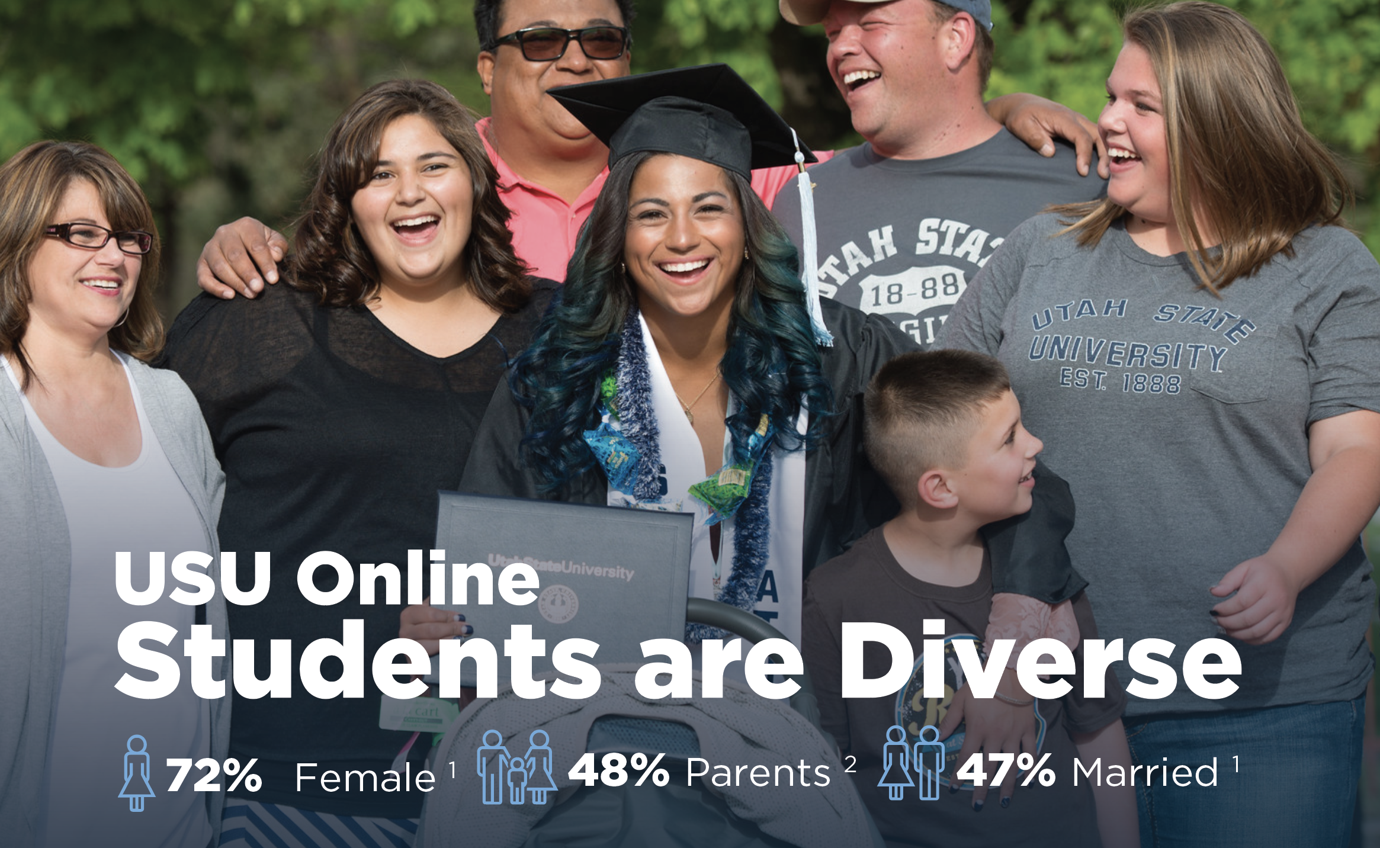
1. USU Online Student Satisfaction Survey | 2019
2. USU Statewide Student Persona Survey | 2018

Slide 22






Utah State University
Students Reap the Benefits
Credit Transfers from Other Universities
2nd Bachelor’s Option for All Online Programs
Financial Aid, Scholarships & Loan Eligibility
E-tutoring Services Available
Free
Testing & Proctoring
Online
Library
Access
Academic Support &
Coaching

Slide 23






Utah State University
Students Reap the Benefits
Peer Mentoring & Study Groups
Online Student Clubs
Student Wellness Support
IT Service
Desk Full Time Support
Veteran & Military Student Resources
Career
Design Center Access
Disability Resource Center Access

Slide 24
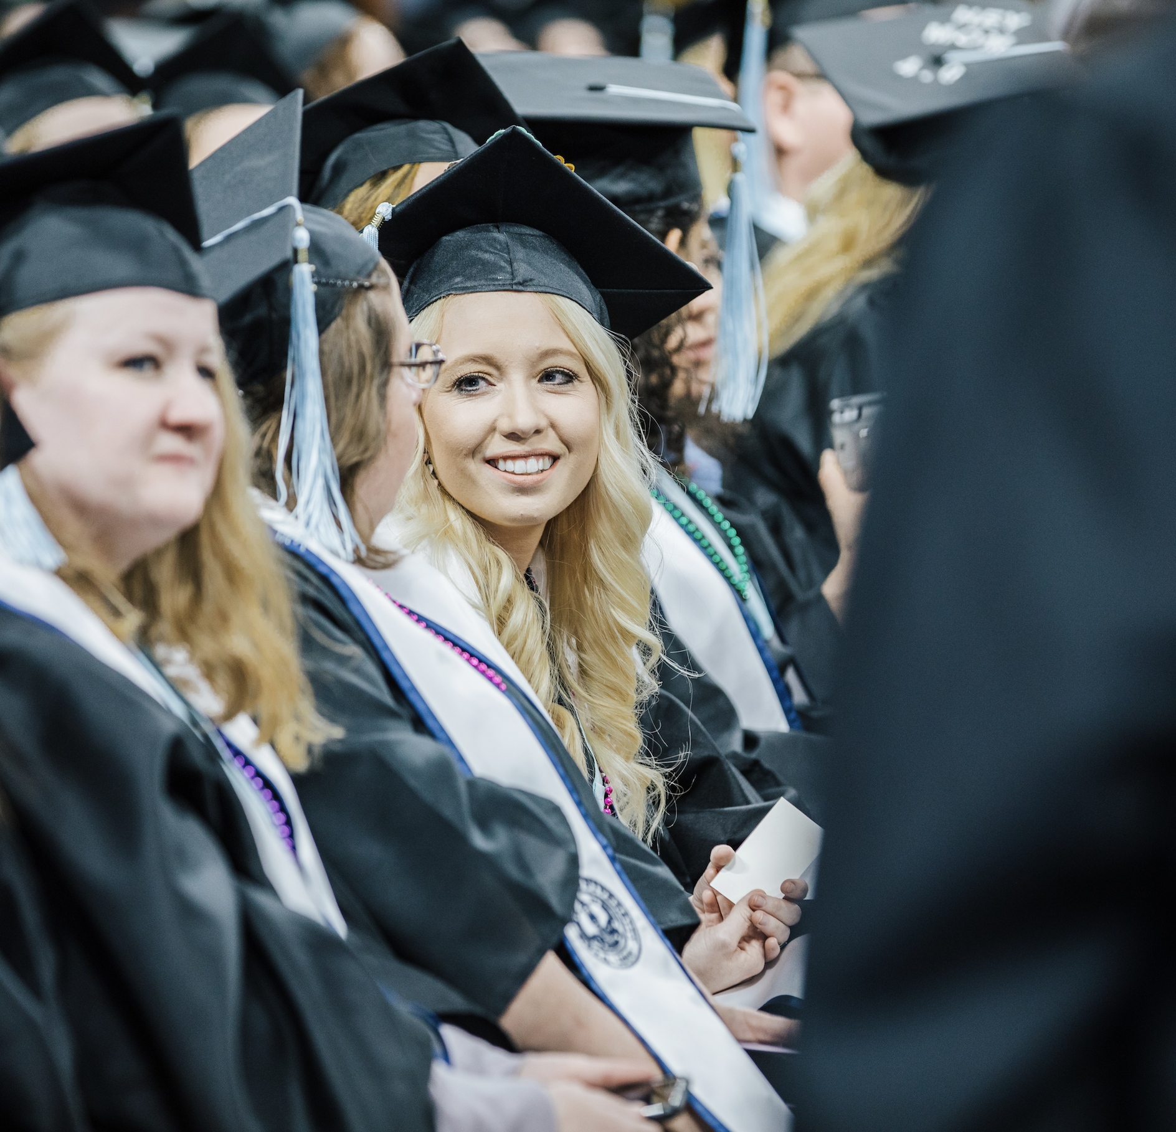
Earned Admissions
We Want You at USU
If students do not meet the criteria for admission for Utah State, they can still be admitted to USU in good standing by successfully completing three self-paced online courses.
$130 Monthly Subscription
Applicants do not pay university tuition and will receive university credit starting Fall 2022.
34 students admitted since Fall 2020.
3 Online Classes
Classes are self-paced with an open-ended structure with recommended deadlines.
English
Math
Study Skills

Slide 25
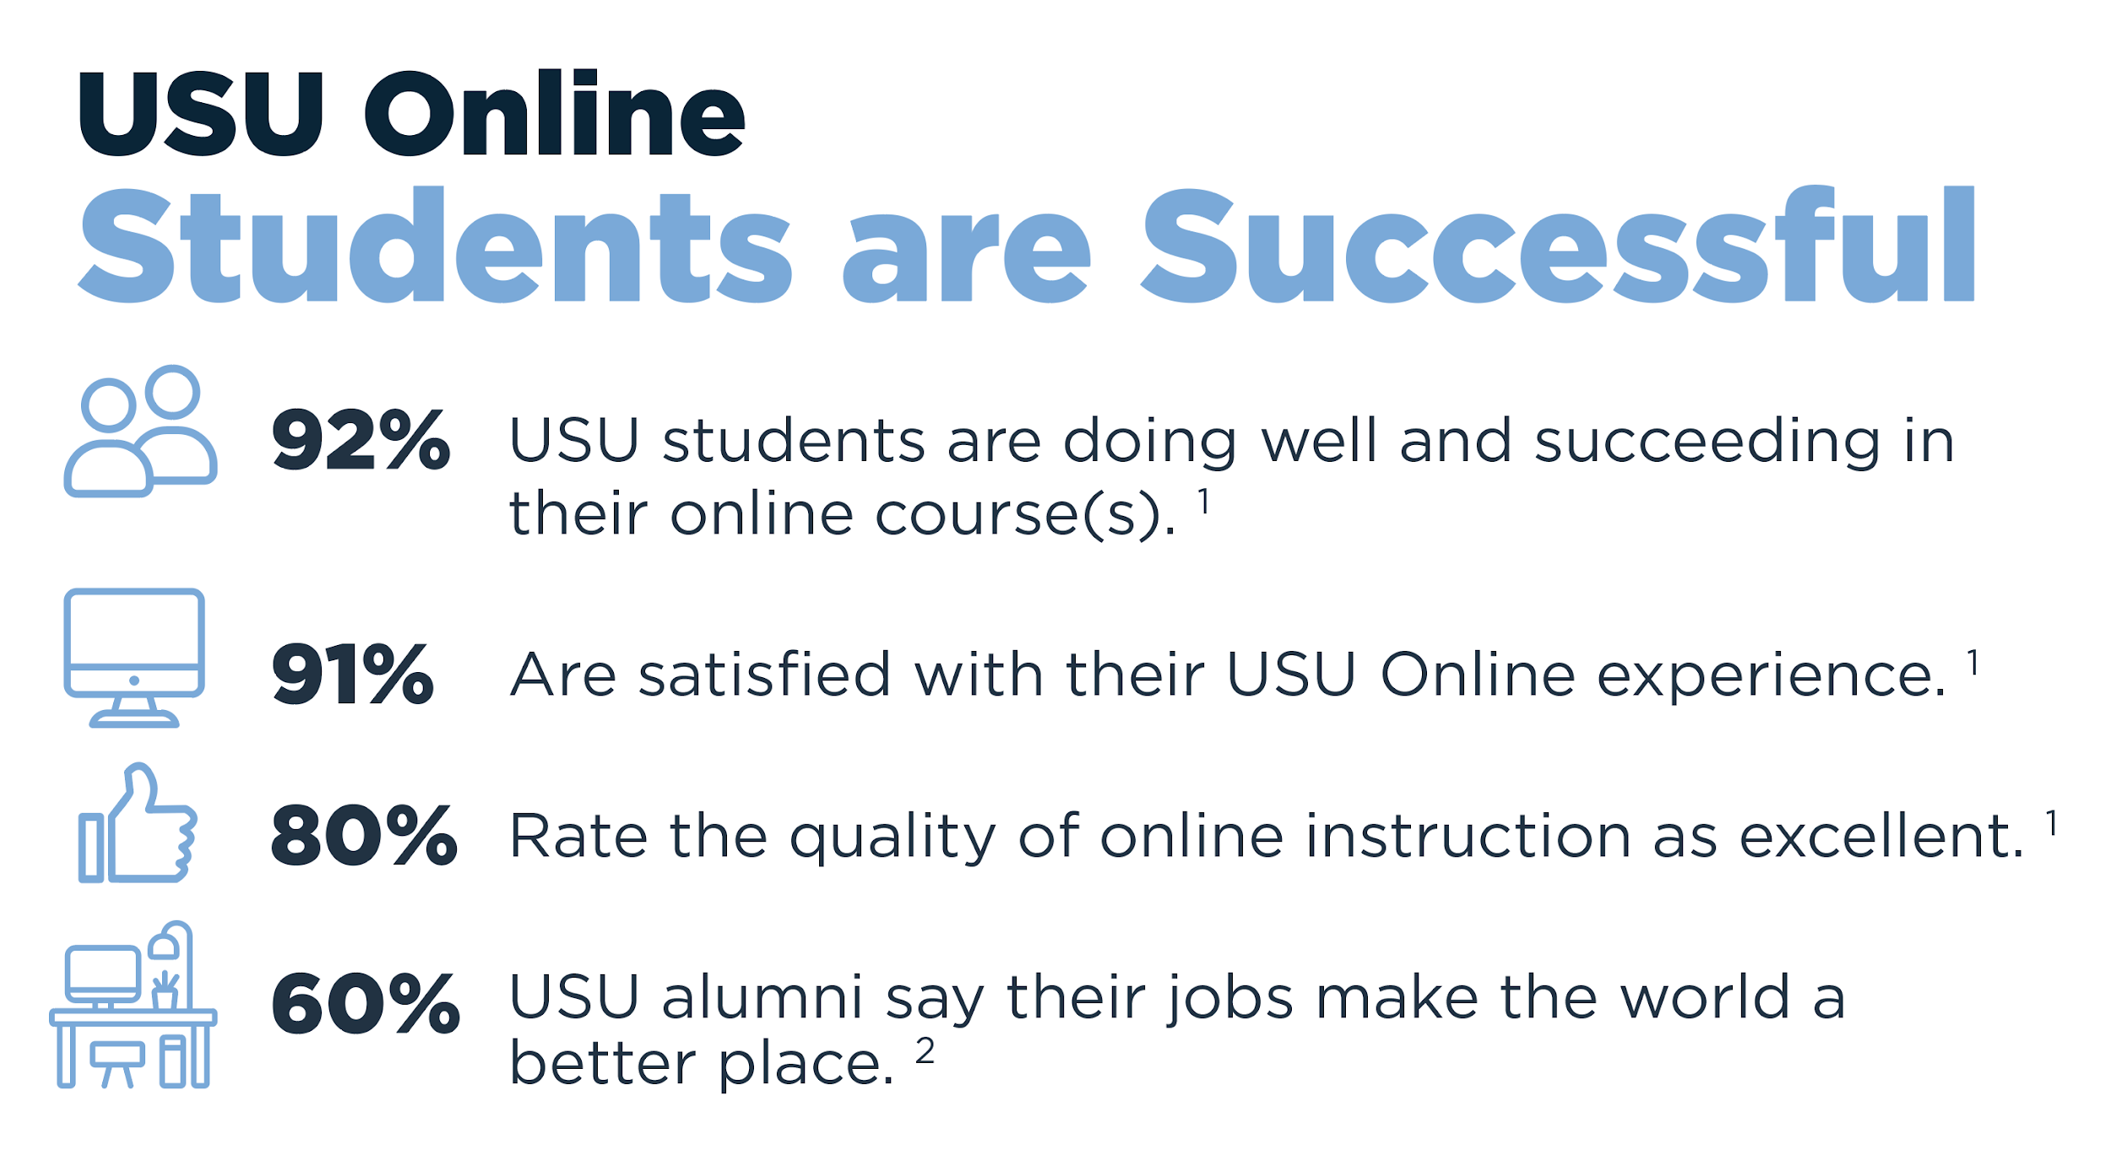
1. USU Online Student Satisfaction Survey | 2019
2. Payscale.com | Utah State University Average Salary

Slide 26
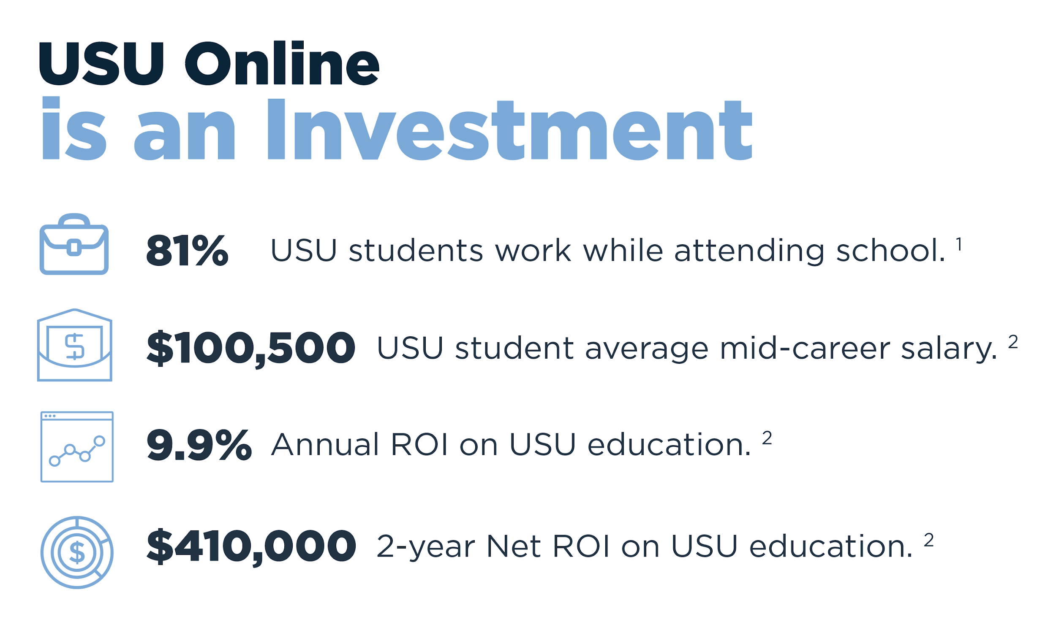
1. USU Statewide Student Persona Survey | 2018
2. Payscale.com | Utah State University Average Salary

Slide 27
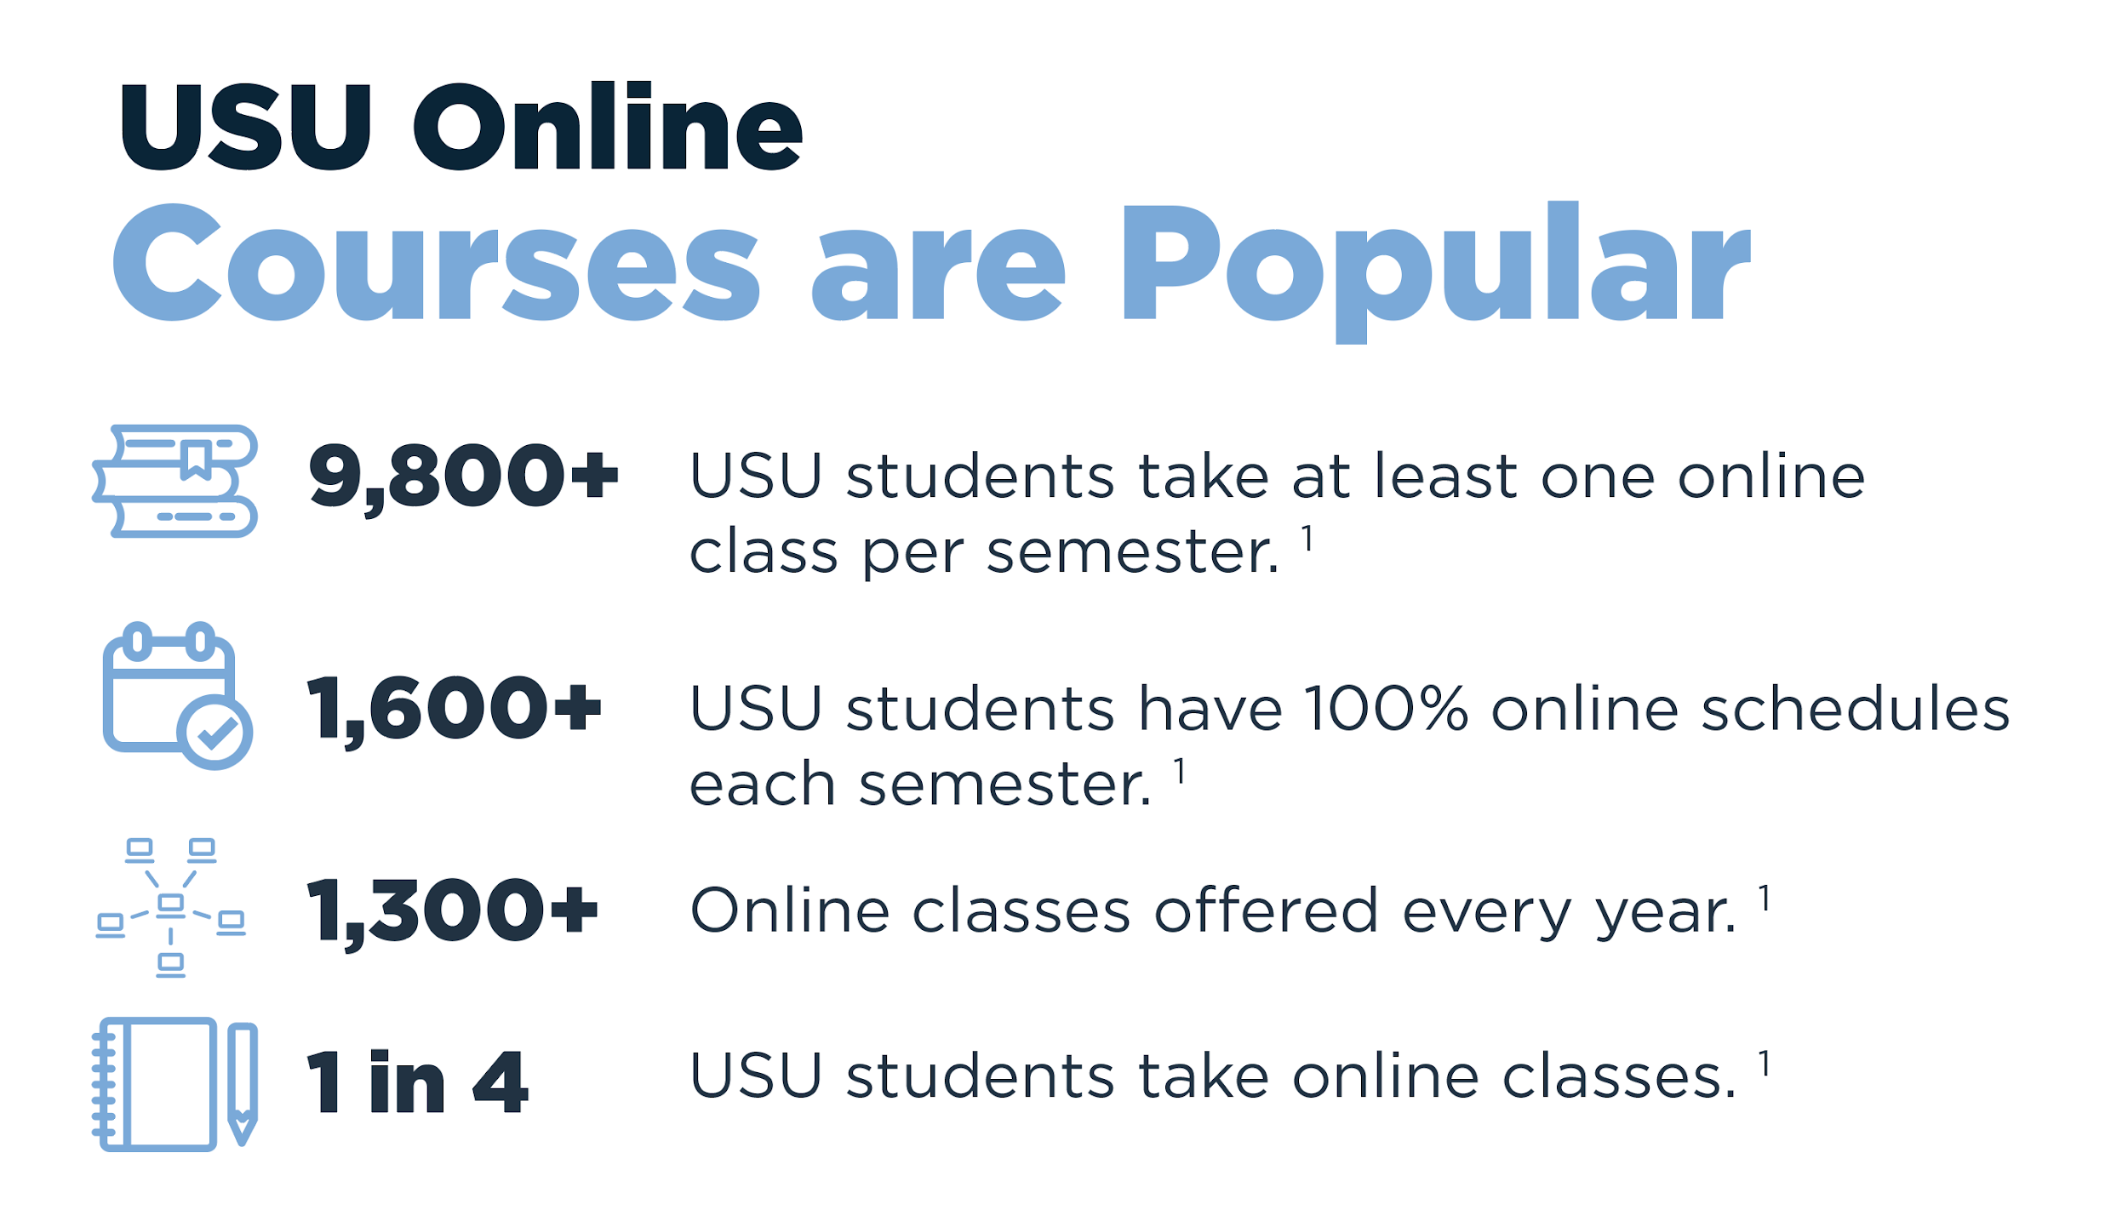
1. USU Statewide Student Persona Survey | 2018

Slide 28

Utah State University
Post-traditional Student Aspirations

Slide 29
Utah State University
Post-traditional Student Solutions
Time
Cost
Technology
Confidence
Online flexibility
Part-time attendance
Childcare options
Local facilities
Affordable quality
FAFSA & scholarships
Tuition plateau
Employer support
Admission support
Success coordination
TBD: computer literacy module
Welcoming environment
Local support staff
Nontraditional Student Association

Slide 30


Thank
you!
Rene Eborn
AVP Strategic Initiatives & USU Online Deputy of Digital Transformation
Utah State University
E: rene.eborn@usu.edu
O: 800.233.2137
Anca Matcovschi
Director of Statewide &
USU Online Recruitment
Utah State University
E: anca.matcovschi@usu.edu
O: 435.797.1086

